Slide 1
The DSP Challenge
Fall 2024

Slide 2
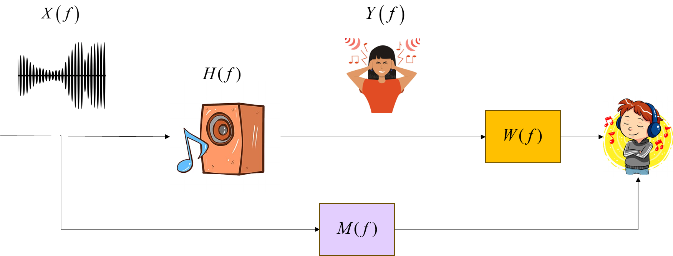
Task Objective
In this challenge, you are asked to design a compensation filter for a loudspeaker to enhance its reproduced audio quality with improved low- frequency extension and broadband response.

Slide 3
Data provided at 44.1 kHz sampling rate
Loudspeaker white noise input signal: input_white_noise.wav
Microphone output (white noise): output_white_noise.wav
Microphone output (music signal): output_music.wav
Desired frequency response specification: desired_frequency_response.npy
Procedures
Grading
Ranking (40% ): ranking based on the Mean Square Error (MSE) of the magnitude of the compensated and desired FRFs and the Perceptual Evaluation of the Audio Quality (PEAQ) of the compensated signal. The ranking is updated daily.
Report (60%): formulation of your proposed approaches, result presentation and discussions, conclusions.

Slide 4
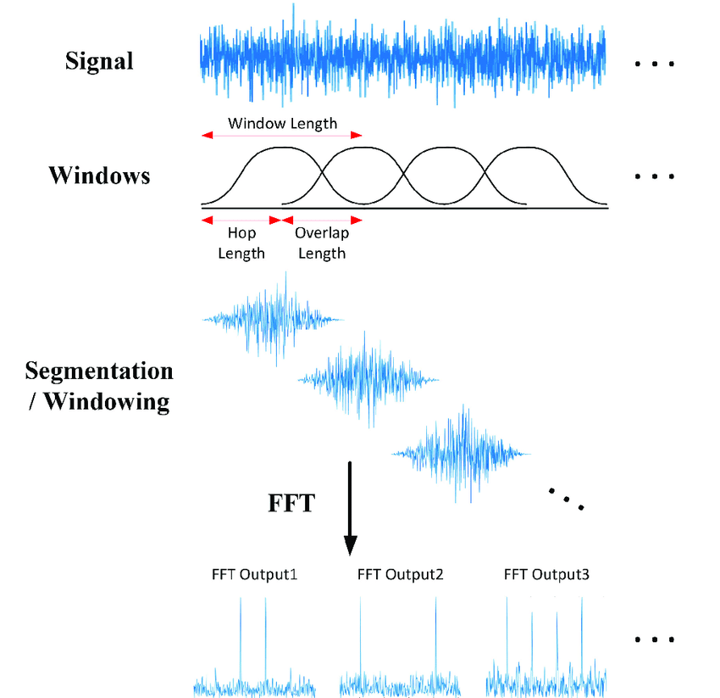
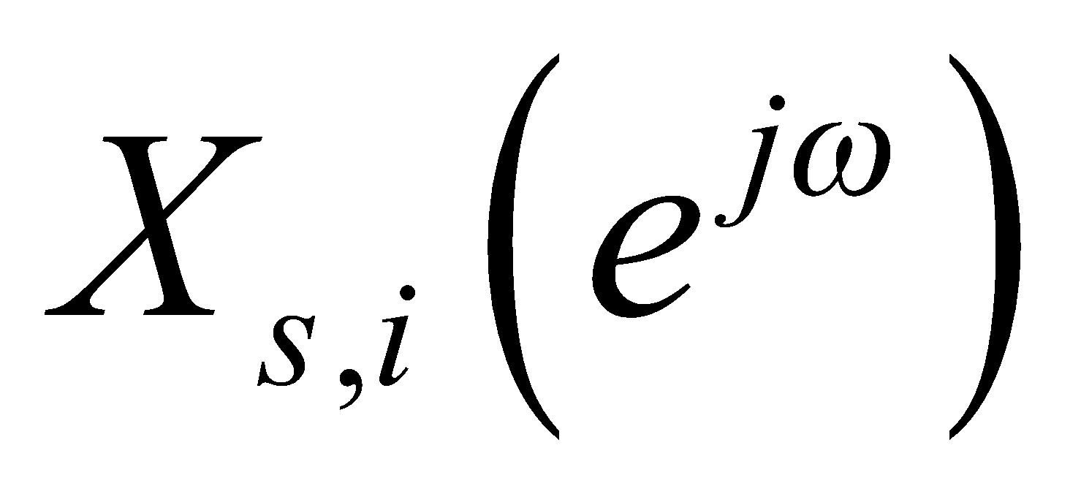
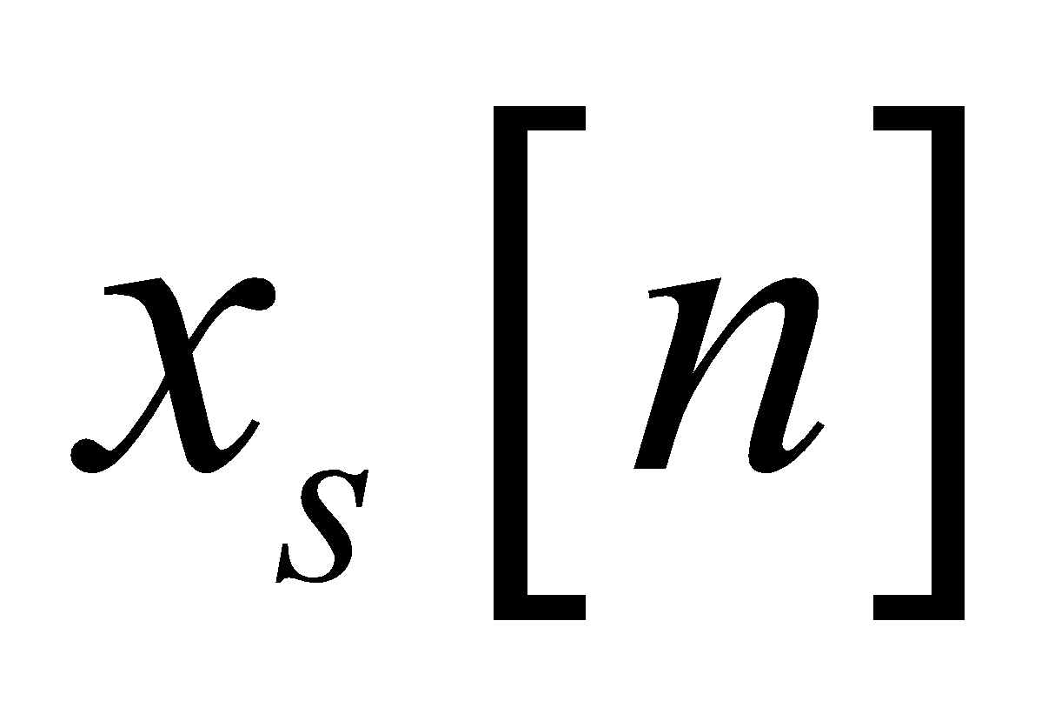
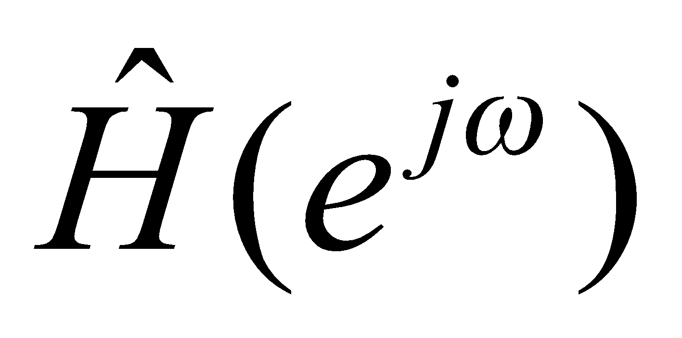
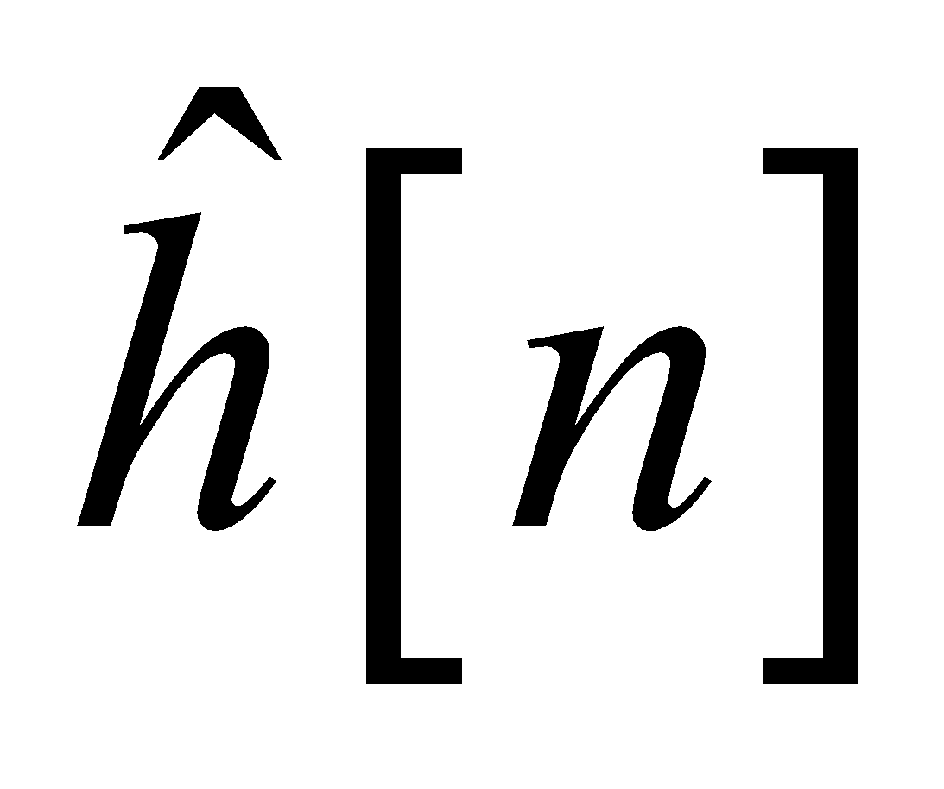
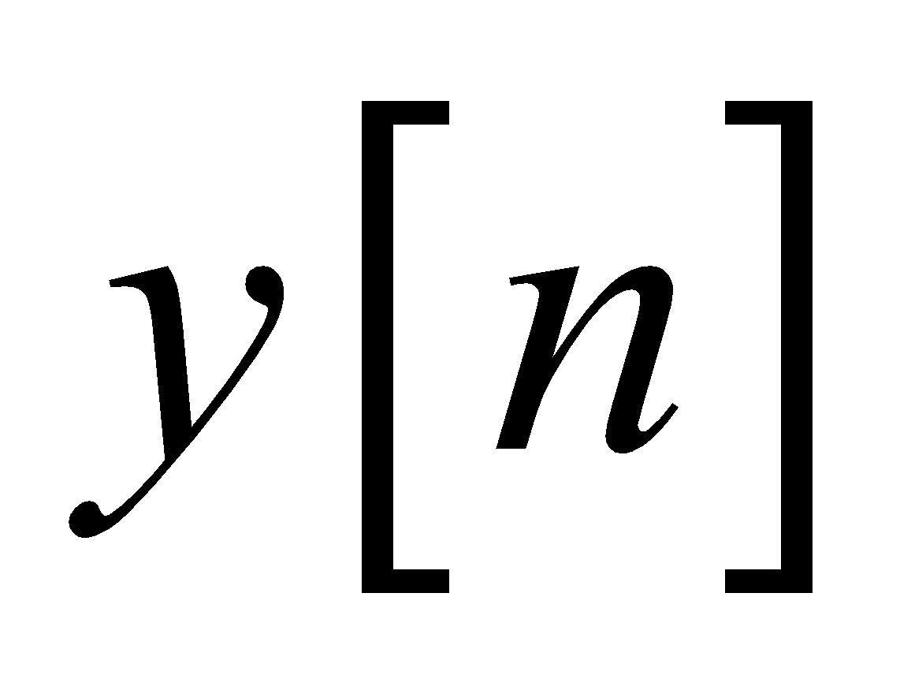
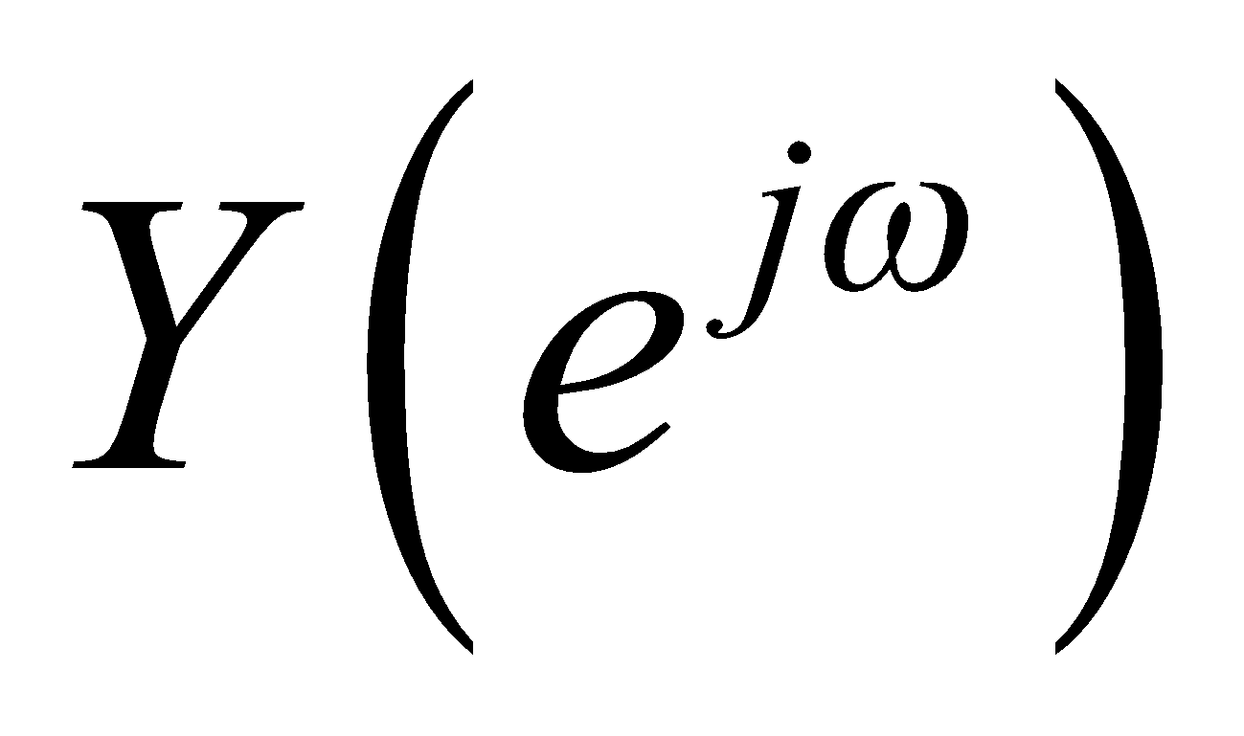
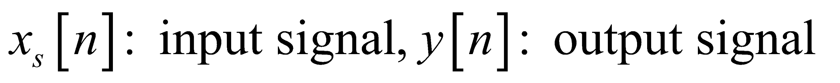
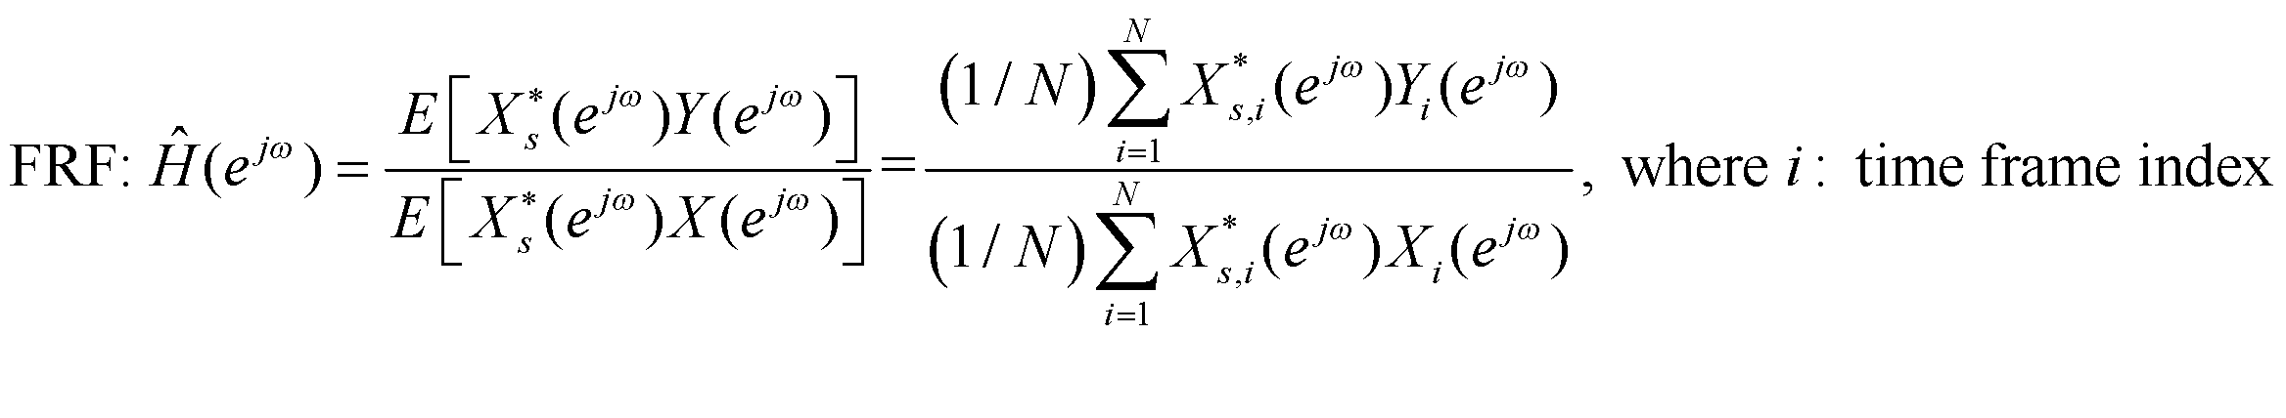
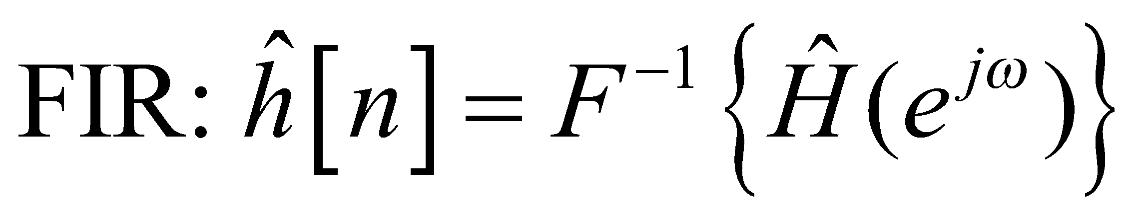
FRF & FIR estimates
STFT
Windowing+ Overlap
Zero padding
FFT
IFFT
Windowing+ Overlap
Zero padding
FFT
Short-time Fourier transform (STFT) : Overlap + windowing + zero padding + FFT

Slide 5
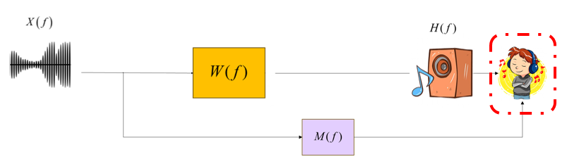
本作業於google classroom進行繳交，盡早開始做。連結如下: https://classroom.google.com/c/NzMwNDUzNTY2MTEy?cjc=5k3h3sf
請同學由此連結加入本課程，於課堂作業區進行作業上傳
所有題目檔案將於eeclass中宣布
請將檔名【output_music_compensated_學號.wav】(Time duration: 7s, Sampling rate: 44.1k Hz)
繳交至課程作業區【Challenge】
※ 音檔分數會於12/02-12/20每天18:00更新至公告中，請同學再自行確認！

Slide 6


